Slide 1
WorkshopPLUS – Power Apps for Power Users 1 Day with Lab Module 3: Building with controls, fields, and formulas
Activate - Power Platform Governance - Leads

Slide 2
Disclaimer

Slide 4
Data types and Variables
Understanding controls
Understanding formulas
Power Apps and Excel formula comparisons

Slide 5
Data Types & Variables

Slide 6
Data types
Number – 123.456
Text – Hello World
Boolean – True or False
DateTime – 1/12/2017 12:00 PM
Date – 1/12/2017
All can hold blank (null) values
Test with IsBlank function
Create with Blank function
Notes:
Also known as Primitive Data Types

Slide 7
Variables – Usage
In general, avoid using variables. But sometimes only a variable can enable the experience you want.
Think Excel when you think about data manipulation and Excel type formulas.
Notes:
https://docs.microsoft.com/en-us/powerapps/maker/canvas-apps/working-with-variables
Discuss:
A great example of why you might want to use variables is when you want to work within a screen, while performing a function that takes time you can use a function within a button to change the text

Slide 8
Variables – Types
Global Variables
App Scope
Usage: Set(MyVar,1)
Context Variables
Screen scope
Usage: UpdateContext({MyVar:1})
Collections
App Scope
Collect(Cars,{Make:Porsche,Year:2019})
Simplest to use
Great for passing values to a screen, much like parameters to a procedure in other languages
Holds a table of data and can be saved to the local device for later use
Notes:
Discuss:
The types of the variable is derived implicitly from the values that are placed in them.
All variables are held in memory while the app is running. After the app closes, the values held in the variables are lost.
You can store the contents of a variable in a Data Source using Patch or Collect functions, or in the case of collections you can store to the local device with the SaveData function.
When the app is first loaded, all variables will have the blank value.
How global variables work:
You set the value of the global variable with the Set function.
You use the global variable by referencing the name used with the Set function. In this case, MyVar will return 1.
Global variables can hold any value, like string, Boolean, numbers, records, and tables.
How context variables work:
You create and set context variables by using the UpdateContext function.
If a context variable doesn't already exist when first updated, it will be created with a default value of blank.
You create and update context variables with records, use { MyVar: 1 }
You can set a context variable when a screen is displayed, by using the Navigate function. This is similar to parameter passing in other programming tools.
Except for Navigate, context variables are limited to the context of a single screen.
Context variables can hold any value, including strings, numbers, records, and tables.
How collections work:
Create and set collections by using the ClearCollect function.
You can use the Collect function instead, but it will effectively require another variable instead of replacing the old one.
A collection is a kind of data source and, therefore, a table.
To access a single value in a collection, use the First function, and extract one field from the resulting record. If you used a single value with ClearCollect, this will be the Value field, as in this example: First( VariableName ).Value
Can be saved to the local device with SaveData, LoadData
Great for taking apps offline
All viewable from the File menu “Variables” and “Collections” tabs
Ref: https://docs.microsoft.com/en-us/powerapps/maker/canvas-apps/functions/function-updatecontext
https://docs.microsoft.com/en-us/powerapps/maker/canvas-apps/functions/function-set
https://docs.microsoft.com/en-us/powerapps/maker/canvas-apps/functions/function-clear-collect-clearcollect

Slide 9
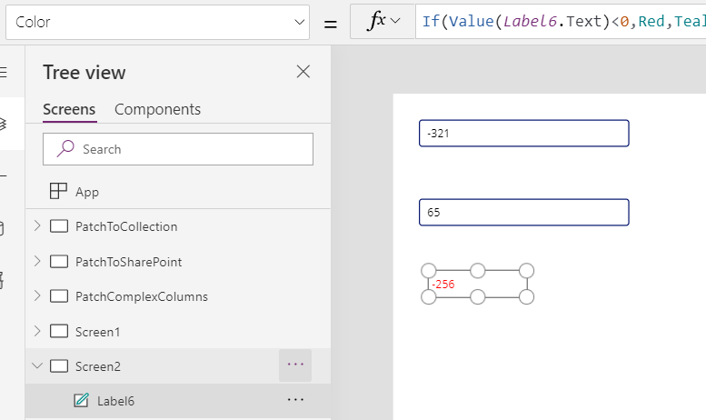
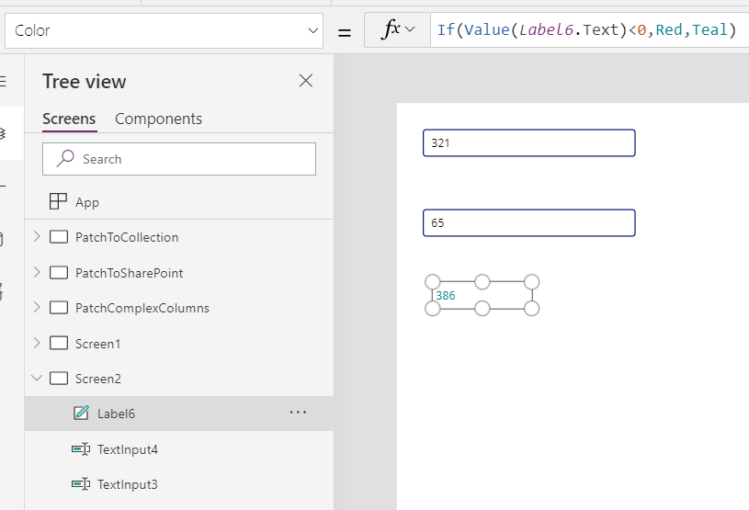
Variables – Using formulas
Replicate Excel behavior in an app by:
Adding a label control and two text input controls.
Setting the text property of TextBox1 to TextInput1 + TextInput2.
This will show the sum of whatever numbers are in the text boxes, automatically.
Notes:
Discuss using formulas :
If you know Excel, you know Power Apps. The model and formula language are the same.
Simplifies coding, reducing work needed to create same feature. Let the formula engine in Power Apps work for you.
Greater control of results (Can’t be updated by other code)
Provides ability to perform ‘What if’ queries by simply returning the formula to it’s start state (Think of a slider can change it up and down and then return to zero)
If you want you can use other sources in your formula like GPS from mobile device or a SharePoint list
https://docs.microsoft.com/en-us/powerapps/maker/canvas-apps/working-with-variables

Slide 10
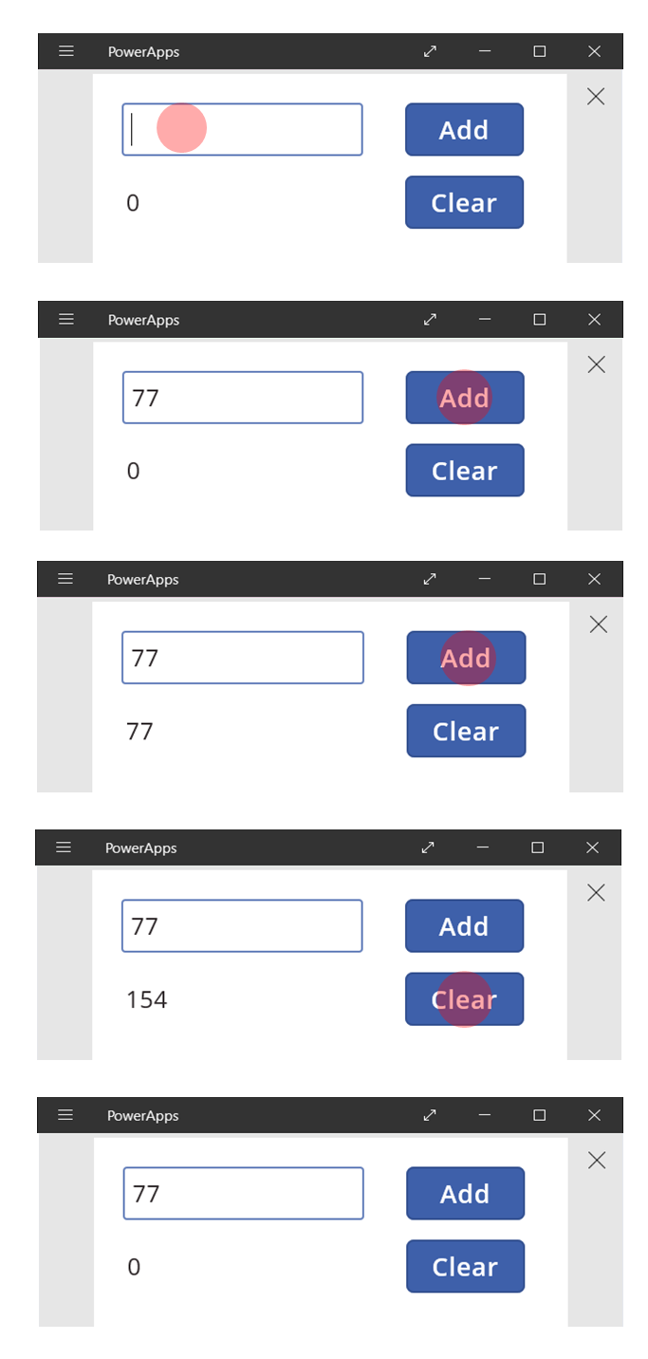
Variables – When to use them
Step1: Insert value in text box.
Step 2: Click Add. Total becomes 77.
Step 3: Click Add. Total becomes 154.
Step 4: Click Clear. Total becomes 0.
Notes:
Discuss:
Variables come with caveats:
Need user action to update the running total. Automatic recalculation won't do it for you.
Changes to the total can come from different user actions. Troubleshooting can be problematic.

Slide 11
State variables
Global variables
App-wide scope
Primary function: Set
Context variables
Local-screen scope (the screen’s “context”)
Pass values to a screen like passing parameters to a procedure
Primary functions: Navigate, UpdateContext
Collections
App-wide scope
Tables only
Primary functions: Collect, Clear, ClearCollect, Update, Remove
Can be saved to the local device with SaveData, LoadData
Great for taking apps offline
All viewable from the file menu Variables and Collections tabs

Slide 12
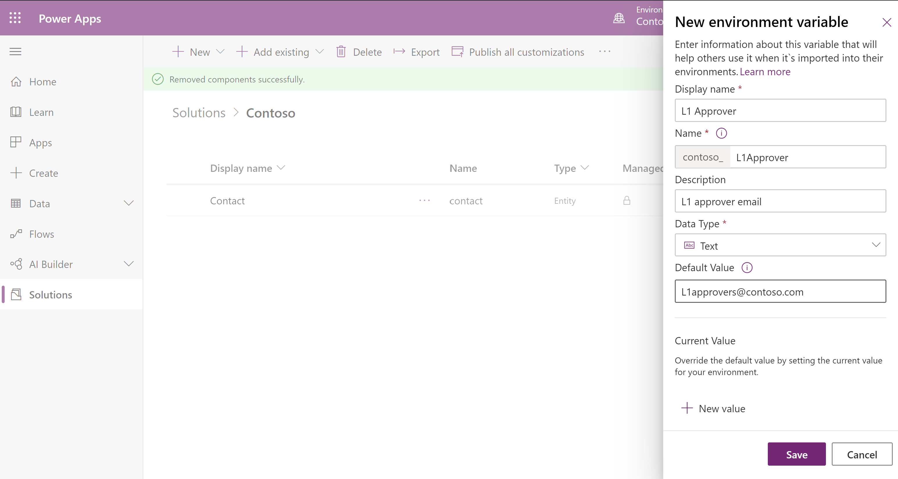
Environment Variables
Used in Solutions
Use with Data sources
Consumed by all components
Can be used in DevOps
Notes:
Environment's variables can be used to:
Provide new parameter values while importing solutions to other environments.
Store configuration for the data sources used in canvas apps and flows.
Package and transport all parts of your customizations from single location.
One environment variable can be used across many different solution components
Mention
Values of variables are easily changed
Supported by DevOps tools enabling continuous integration and continuous delivery (CI/CD).
The environment variables can be unpacked and stored in source control.
Discuss
Variables can be created and modified with solution interface
Created when connecting to data sources in canvas or imported to an environment via solutions.
They are inputs when authoring Power platform objects like Apps, Flows, or Power BI Dashboards.
The environment variable values are then derived when solutions are imported to other environments.

Slide 13
Understanding Controls

Slide 14
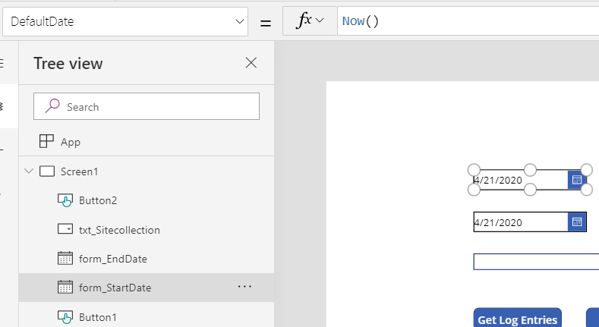
Controls and formulas
Controls show or get information
Formulas manipulate data
Formula bar
Formula
Property
Controls
Notes:
Discuss:
Controls have properties, each with a formula
Each control has many properties
Controls and their properties are global scope (available everywhere)
Screen are also controls and have properties
Formulas define dependencies between control properties
Lots of little pieces of “code”
No large monolithic procedures
Only one path determines a value, easier to understand what is happening
Language is modeled after Excel for power users

Slide 15
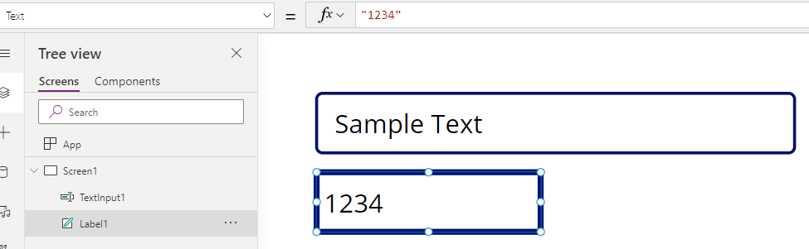
Text input and Label Controls
Text input is a box in which the user can type
Label is a box that shows data
Formula
Property
Text Input
Control
Label
Control
Notes:
Label control
Box that shows data such as text, numbers, dates, or currency.
Labels often appear:
Outside of any other control (such as a banner that identifies a screen)
As a label that identifies another control (such as a rating or audio control)
In a gallery to show a specific type of information about an item
Text input
Type text, numbers, and other data.
Can specify data by typing into a text-input control
Depending on how the app is configure one can:
Data might be added to a data source
Used to calculate a temporary value
Be incorporated in some other way

Slide 16
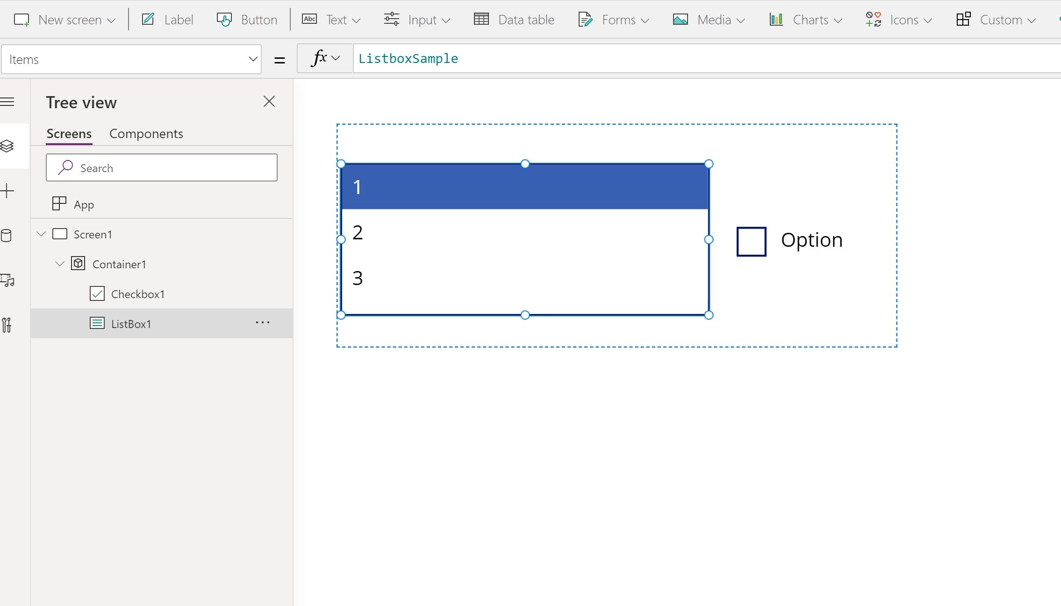
Container
Provides the ability to create hierarchy
Can hold a set of controls and has its own properties
Container
Notes:
You can start with inserting a blank container. And then, customize it by adding controls to it, resizing it, moving it, hiding it, and making other changes. You can also start with a number of controls, select them and add using tree view.
Container control in Power Apps - Power Apps | Microsoft Docs

Slide 17
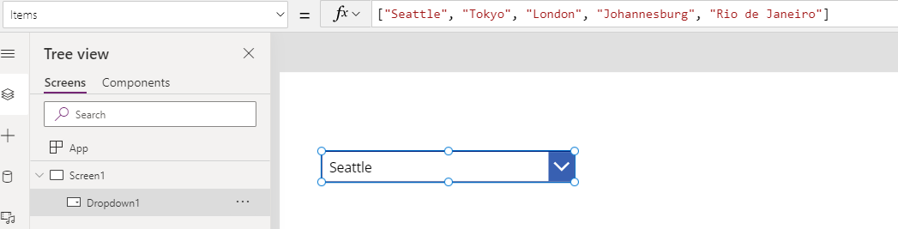
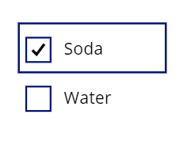
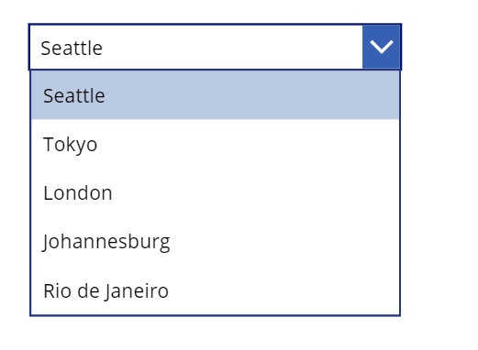
Drop Down and Check Box
Drop Down shows only the first item unless it is opened
Check box allows the user to set its value to true or false
Formula
Property
First item of List
True
False
List Opened
Notes:
Drop Down Control
Conserves screen real estate, especially when the list contains a large number of choices
Control takes up only one line unless the user selects the chevron to reveal more choices
Control will show a maximum of 500 items
Check box
The user can specify a Boolean value by using this familiar control, which has been used in GUIs for decades.

Slide 18
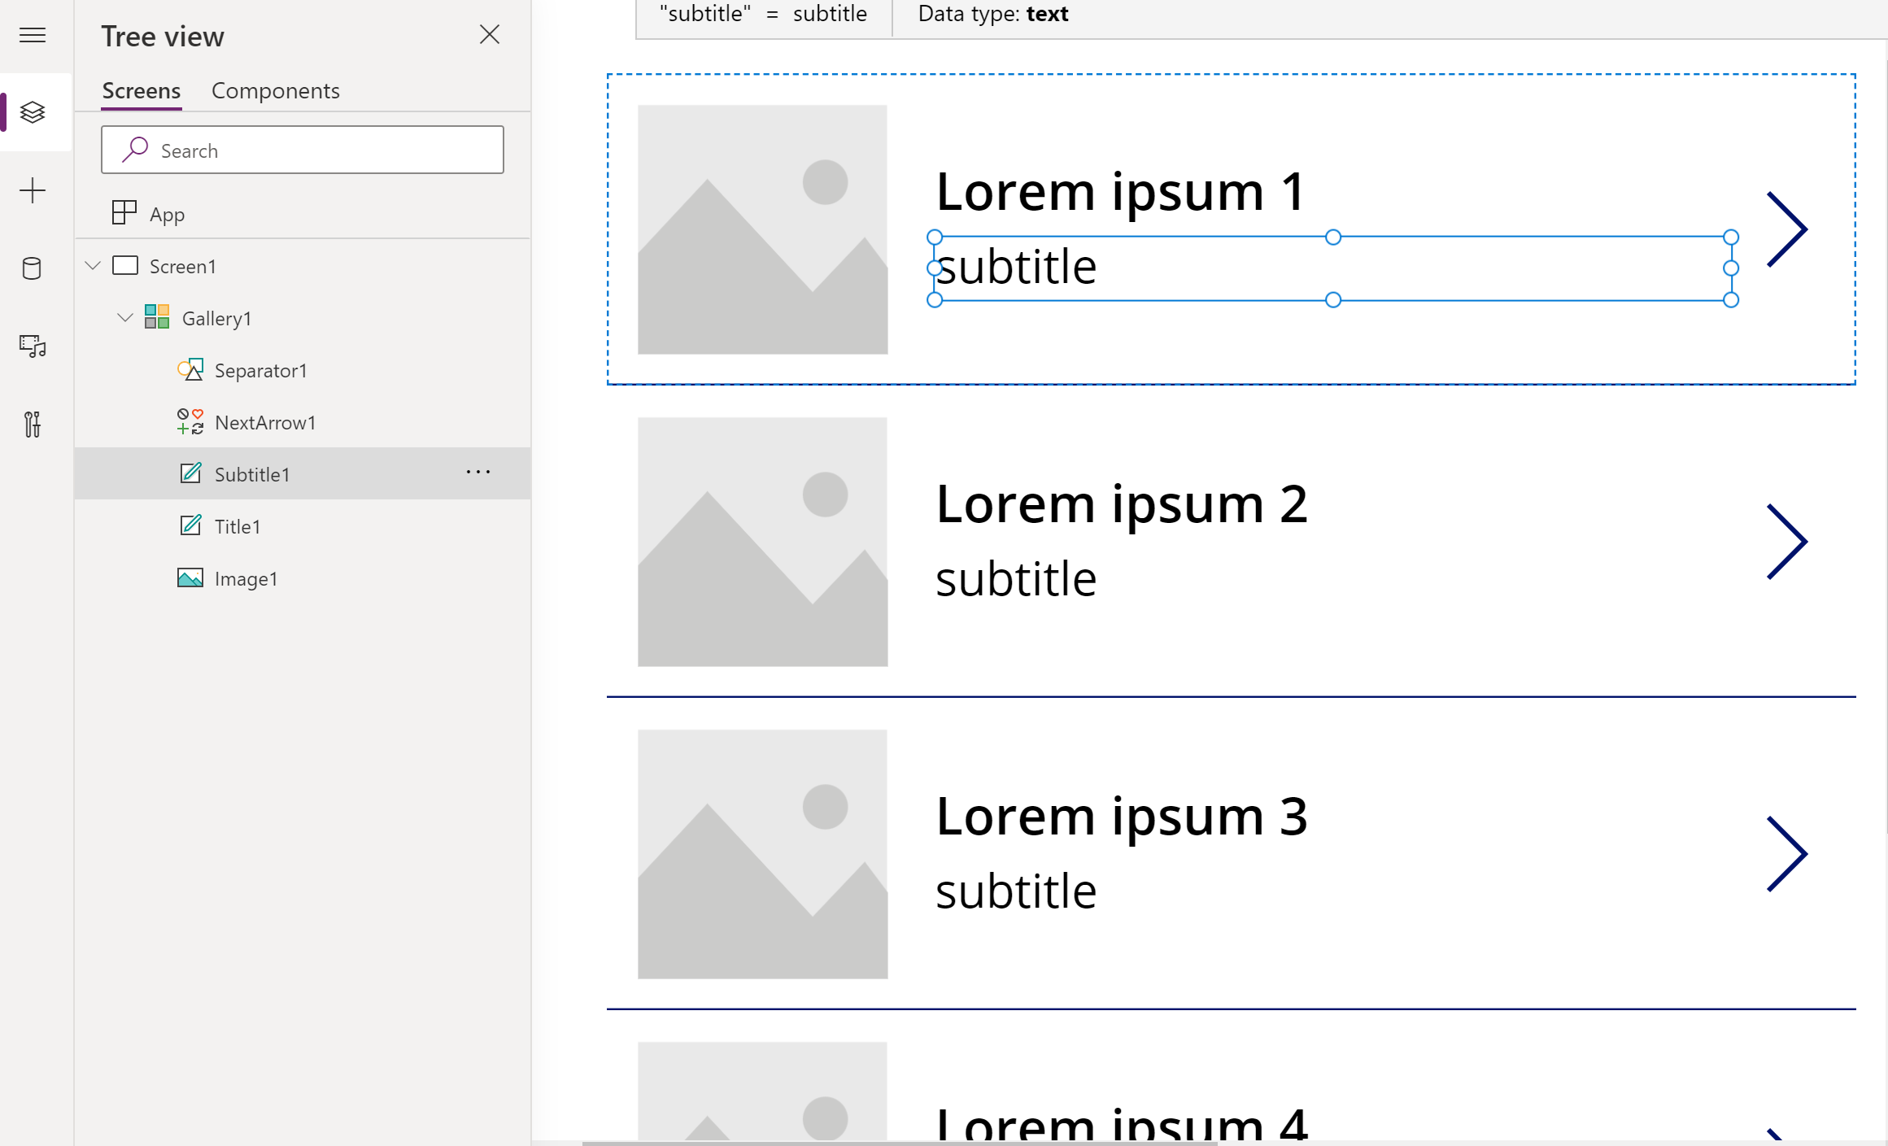
Gallery
Gallery is a control that contains other controls and shows a set of data
Notes:
Each data field appears in a separate control within the Gallery control. And you can configure those controls in its template. The template appears as the first item inside the gallery:
On the left edge of a Gallery control in horizontal/landscape orientation.
And at the top of a Gallery control in vertical/portrait orientation.
Any changes that you make in the template are reflected throughout the Gallery control.
Predefined templates for showing images and text in a gallery are available, and a gallery for variable-height items.

Slide 19
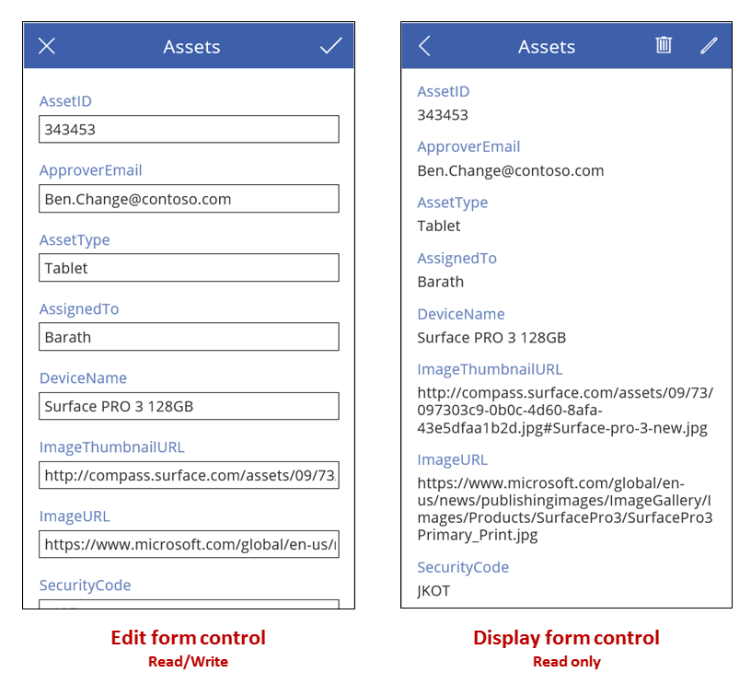
Forms
Forms can create, edit and display a record in a data source

Slide 20
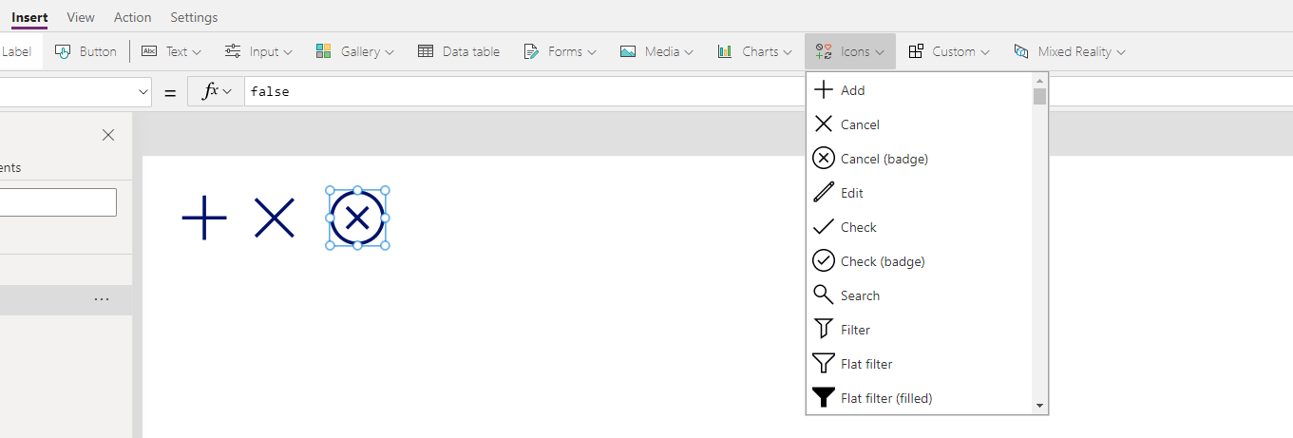
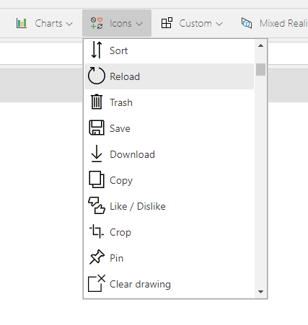
Icons
Graphics for which you can configure appearance and behavior properties.
Located in Insert Tab
More Options
Notes:
These controls include arrows, geometric shapes, action icons, and symbols for which you can configure properties such as fill, size, and location. You can also configure their OnSelect property so that the app responds if the user selects the control.
Shape and Icon controls in Power Apps - Power Apps | Microsoft Docs

Slide 21
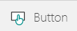
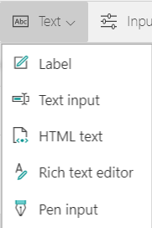
Commonly used controls
Interact with app by clicking or tapping
Show data such as text, numbers, date, or currency
Type text, numbers, or other data
Convert HTML tags automatically
Draw an image or text and save it to app or data source

Slide 22
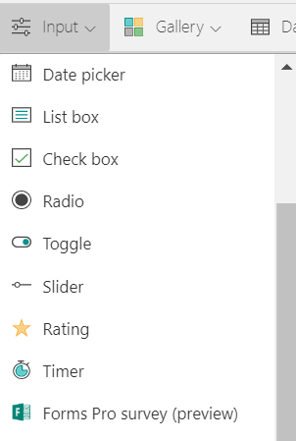
Mobile-friendly controls
Select or clear an option to specify true or false
Show options that are mutually exclusive
Drag a handle to specify true or false
Specify a value by dragging a handle
Indicate a value between 1 and a specified number

Slide 23
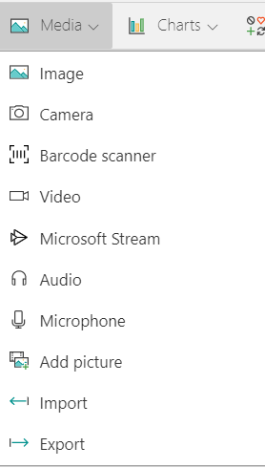
Media controls
Show an image from, for example, a local file or a data source.
Take and save photos in the app or to a data source.
Scan a barcode by using a device that has a camera.
Play a video clip from a local file, a data source, or YouTube.
Play an audio clip or the audio portion of a video clip.
Record and save sounds in the app or to a data source.
Load images from the local device for upload to a data source.

Slide 24
Create device gallery and setup filters
Objectives
After completing this lab, you will be able to:
Add device gallery and connect to data source.
Arrange the device gallery.
Add gallery to show manufacturers.
Scenario
The organization wishes to build apps using the Power Apps platform to take advantage of No Code/Low Code application development in the cloud. As part of this effort, you are required to add controls and create formulas to add functionality to your app.
Notes:
See lab file M3_PowerApps_PowerUser_BuildingwithControlsFieldsandFormulas.docx and complete Exercises 1 - 3

Slide 25
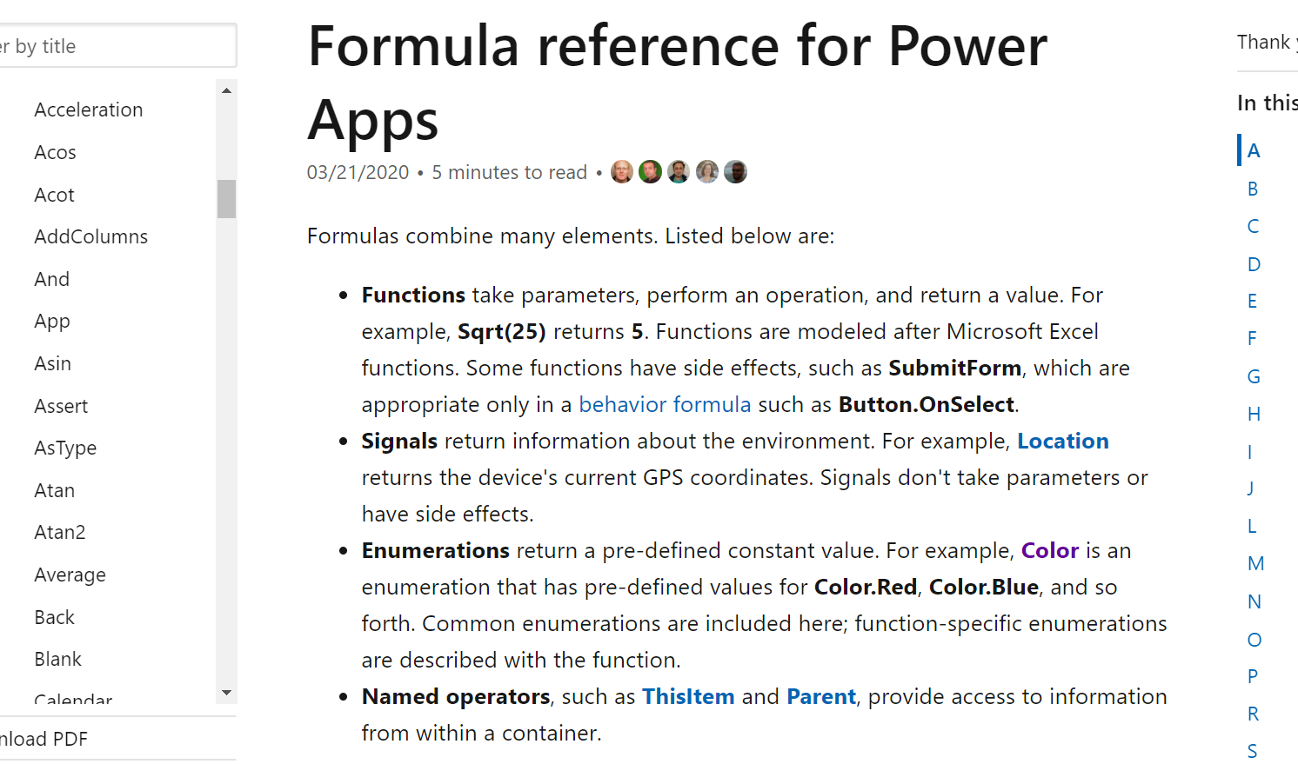
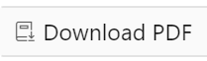
Formula types
Math
DateTime
String manipulation
Working with data records
Can download full PDF reference
Notes:
Power Apps contains many built-in formulas across the following categories:
Math functions such as Average, Median, etc.
Data time functions such as Now
String manipulation functions such as ToUpper, ToLower, SubString, etc.
Formulas for working with data records (Find, Filter, etc.)
Update link below: https://docs.microsoft.com/en-us/powerapps/maker/canvas-apps/formula-reference
https://powerapps.microsoft.com/en-us/tutorials/formula-reference/

Slide 26
Elements of formulas
Functions
Signals
Enumerations
Named Operators
Notes:
Discuss:
Functions
Take parameters, perform an operation, and return a value.
Modeled after Microsoft Excel functions. For example, Sqrt(25) returns 5.
Signals
Return information about the environment. i.e. Location returns the device's current GPS coordinates.
Don’t handle parameters or have side effects.
Enumerations
Return a pre-defined constant value i.e. Color is an enumeration that has pre-defined values for Color.Red, Color.Blue, and so forth.
Named Operators
- Named operators such as ThisItem and Parent, provide access to information.

Slide 27
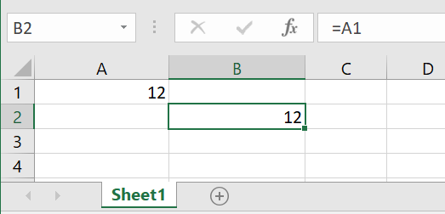
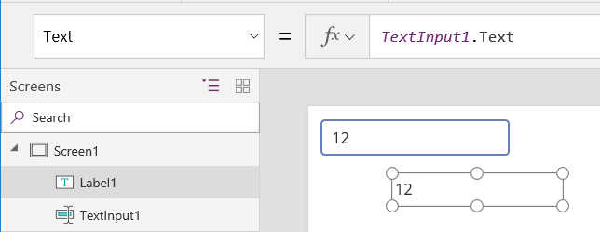
Formula references
Excel
Power Apps
Notes:
Discuss:
How in Excel
B1’s cell value depends on A1’s cell value
Automatically recalculated as A1 changes
How in Power Apps
Label1’s Text property depends on TextInput1’s Text property
Automatically recalculated as TextInput1 changes

Slide 28
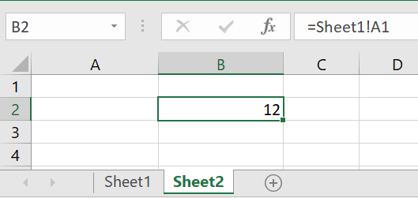
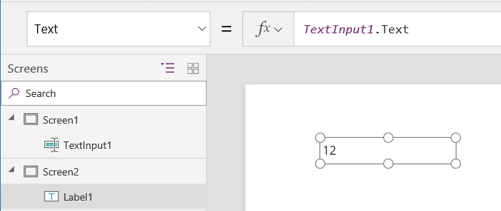
References across sheets/screens
Excel
Power Apps
Notes:
Discuss:
How in Excel
Formulas can reference any cell in the workbook
The entire workbook is recalculating all the time, even if we can’t see a sheet or hidden column
How in PowerApps
Formulas can reference any control property in the app
The entire app is recalculating all the time, even if we can’t see a screen or a control is invisible

Slide 29
Create manufacturer gallery and setup filters
Objectives
Connect ManufacturerGallery to manufacturer's table.
Highlight the selected item in the gallery.
Filter the devices based on the selected manufacturer.
Configure text labels in the device gallery.
Apply conditional formation to highlight devices above $1,000.
Add a checkbox to add a device to the Compare list.
Create a collection for the selected devices.
Set the default selection to the first manufacturer and test the app.
Scenario
The organization wishes to build apps using the Power Apps platform to take advantage of No Code/Low Code application development in the cloud. As part of this effort, you are required to add controls and create formulas to add functionality to your app.
Notes:
See lab file M3_PowerApps_PowerUser_BuildingwithControlsFieldsandFormulas.docx and complete Exercises 4 - 11

Slide 30
Name 3 variable types.
Global, Context, and Collections
2. Name 2 Function types.
Math, DateTime, String manipulation, or Working with data records

Slide 31
Data types
Understanding controls
Understanding formulas
Power Apps and Excel formula comparisons

